Slide 1
Introduction to
Information Security
By: Mohamed Nismy

Slide 2
What is Security?
“The quality or state of being secure—to be free from danger”
A successful organization should have multiple layers of security in place:
  Physical security
  Personal security
  Operations security
  Communications security
  Network security
  Information security
Notes:
What Is Security?
In general, security is “the quality or state of being secure--to be free from danger.”
It means to be protected from adversaries--from those who would do harm, intentionally or otherwise.
What Is Security?
A successful organization should have the following multiple layers of security in place for the protection of its operations:
Physical security - to protect the physical items, objects, or areas of an organization from unauthorized access and misuse.
Personal security – to protect the individual or group of individuals who are authorized to access the organization and its operations.
Operations security – to protect the details of a particular operation or series of activities.
Communications security – to protect an organization’s communications media, technology, and content.
Network security – to protect networking components, connections, and contents.

Slide 3
What is Information Security?
The protection of information and its critical elements, including systems and hardware that use, store, and transmit that information
Necessary tools: policy, awareness, training, education, technology
C.I.A. triangle was standard based on confidentiality, integrity, and availability
C.I.A. triangle now expanded into list of critical characteristics of information
Notes:
What Is Information Security?
Information security, therefore, is the protection of information and its critical elements, including the systems and hardware that use, store, and transmit that information.
But to protect the information and its related systems from danger, tools, such as policy, awareness, training, education, and technology are necessary.
The C.I.A. triangle has been considered the industry standard for computer security since the development of the mainframe. It was solely based on three characteristics that described the utility of information: confidentiality, integrity, and availability.
The C.I.A. triangle has expanded into a list of critical characteristics of information.

Slide 4
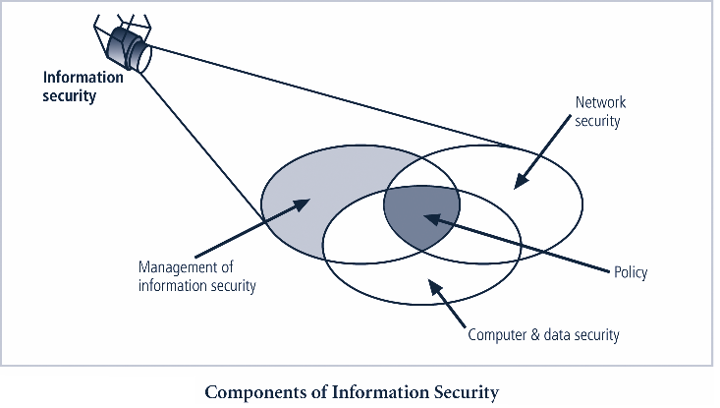

Slide 5
Critical Characteristics of Information
The value of information comes from the characteristics it possesses:
  Availability
  Accuracy
  Authenticity
  Confidentiality
  Integrity
  Utility
  Possession
Notes:
Critical Characteristics Of Information
The value of information comes from the characteristics it possesses.
Availability - enables users who need to access information to do so without interference or obstruction and in the required format. The information is said to be available to an authorized user when and where needed and in the correct format.
Accuracy- free from mistake or error and having the value that the end-user expects. If information contains a value different from the user’s expectations due to the intentional or unintentional modification of its content, it is no longer accurate.
Authenticity - the quality or state of being genuine or original, rather than a reproduction or fabrication. Information is authentic when it is the information that was originally created, placed, stored, or transferred.
Confidentiality - the quality or state of preventing disclosure or exposure to unauthorized individuals or systems.
Integrity - the quality or state of being whole, complete, and uncorrupted. The integrity of information is threatened when the information is exposed to corruption, damage, destruction, or other disruption of its authentic state.
Utility - the quality or state of having value for some purpose or end. Information has value when it serves a particular purpose. This means that if information is available, but not in a format meaningful to the end-user, it is not useful.
Possession - the quality or state of having ownership or control of some object or item. Information is said to be in possession if one obtains it, independent of format or other characteristic. While a breach of confidentiality always results in a breach of possession, a breach of possession does not always result in a breach of confidentiality.

Slide 6
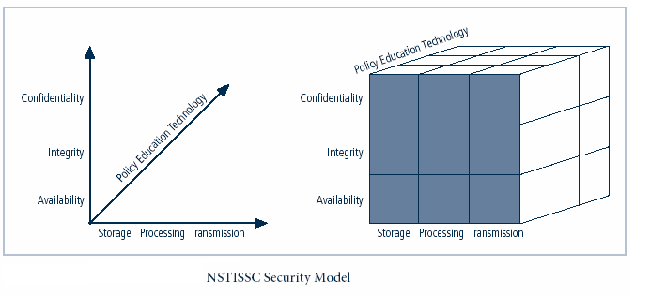
Figure 1-4 – NSTISSC Secu
National Security Telecommunications and Information Systems Security Committee
NSTISSC Security Model
Notes:
This graphic informs the fundamental approach of the chapter and can be used to illustrate the intersection of information states (x-axis), key objectives of C.I.A. (y-axis) and the three primary means to implement (policy, education and technology).

Slide 7
Components of an Information System
Information System (IS) is entire set of software, hardware, data, people, procedures, and networks necessary to use information as a resource in the organization
Notes:
Components Of An Information System
To fully understand the importance of information security, it is necessary to briefly review the elements of an information system.
An Information System (IS) is much more than computer hardware; it is the entire set of software, hardware, data, people, and procedures necessary to use information as a resource in the organization.

Slide 8
Securing Components
Computer can be subject of an attack and/or the object of an attack
  When the subject of an attack, computer is used as an active tool to conduct attack
  When the object of an attack, computer is the entity being attacked
Notes:
Securing The Components
When considering the security of information systems components, it is important to understand the concept of the computer as the subject of an attack as opposed to the computer as the object of an attack.
When a computer is the subject of an attack, it is used as an active tool to conduct the attack. When a computer is the object of an attack, it is the entity being attacked.

Slide 9
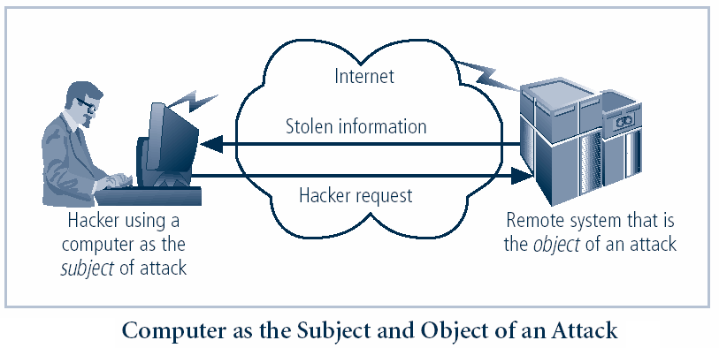
Figure 1-5 – Subject and Object of Attack
Notes:
It is important to note that the same computer can be both the subject and object of an attack, especially in multi-user systems.

Slide 10
Balancing Information Security and Access
Impossible to obtain perfect security—it is a process, not an absolute
Security should be considered balance between protection and availability
To achieve balance, level of security must allow reasonable access, yet protect against threats
Notes:
Security And Access Balancing
When considering information security, it is important to realize that it is impossible to obtain perfect security. Security is not an absolute; it is a process not a goal.
Security should be considered a balance between protection and availability.
To achieve balance the level of security must allow reasonable access, yet protect against threats.

Slide 11
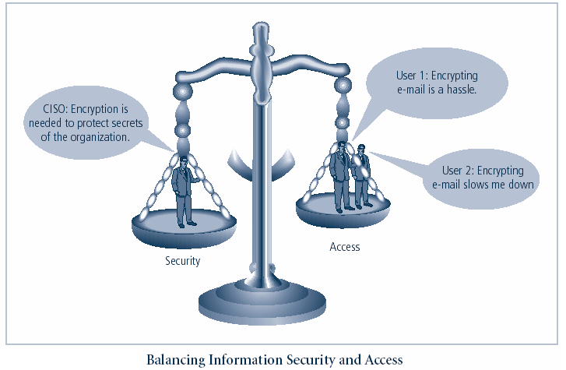
Figure 1-6 – Balancing Security and Access
Notes:
This graphic intends to show that tradeoffs between security and access.

Slide 12
Approaches to Information Security Implementation: Bottom-Up Approach
Grassroots effort: systems administrators attempt to improve security of their systems
Key advantage: technical expertise of individual administrators
Seldom works, as it lacks a number of critical features:
  Participant support
  Organizational staying power
Notes:
Bottom Up Approach To Security Implementation
Security can begin as a grass-roots effort when systems administrators attempt to improve the security of their systems. This is referred to as the bottom-up approach.
The key advantage of the bottom-up approach is the technical expertise of the individual administrators.
Unfortunately, this approach seldom works, as it lacks a number of critical features, such as participant support and organizational staying power.

Slide 13
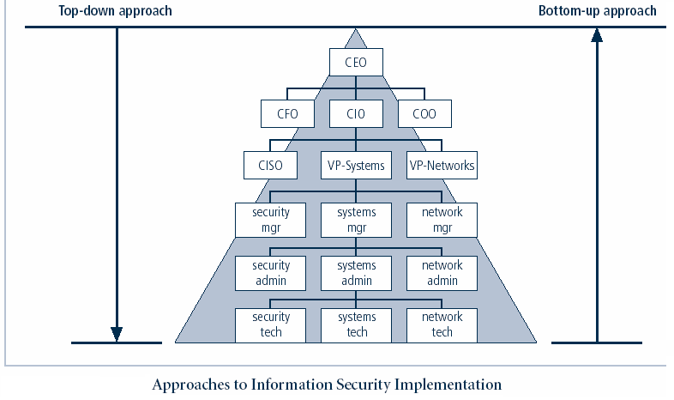
Notes:
Key concept here is the direction of the left and right side arrows to show where planning is sourced and from which direction the pressure for success if driven.

Slide 14
Approaches to Information Security Implementation: Top-Down Approach
Initiated by upper management
  Issue policy, procedures and processes
  Dictate goals and expected outcomes of project
  Determine accountability for each required action
The most successful also involve formal development strategy referred to as systems development life cycle
Notes:
Top-down Approach to Security Implementation
An alternative approach, which has a higher probability of success, is called the top-down approach. The project is initiated by upper management who issue policy, procedures and processes, dictate the goals and expected outcomes of the project, and determine who is accountable for each of the required actions.
The top-down approach has strong upper management support, a dedicated champion, dedicated funding, clear planning and the opportunity to influence organizational culture.
The most successful top-down approach also involves a formal development strategy referred to as a systems development life cycle.

